Slide 1
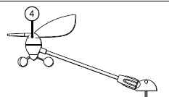
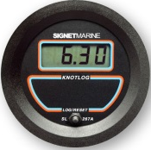
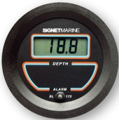
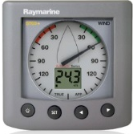
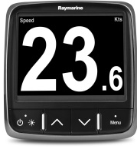
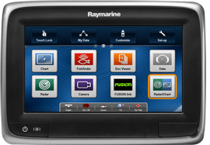
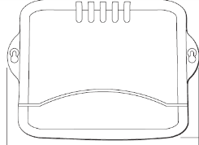
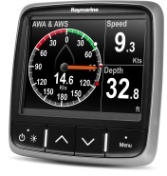
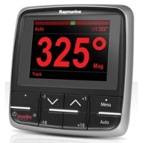
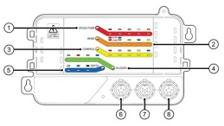
Raymarine set-up 2014
GPS
Antennae
Seatalk1 Plug to Plug
3m/9.8ft
(D285) – extra
Signet
Depth
Backbone Cable
9.75 ft (A06035)
Signet
Speed
ST60+ Wind
Display
(already installed)
Navpod
GP1170/GP2170
Fluxgate
Compass
(already installed)
Chartplotter &
Boat Speed
Existing Seatalk1 Cable
Race Timer or
Boat Speed
Wifi
I70 Display
Spur 3.25ft
(A06039)
Nav Station
Wind display &
Wind Speed
Spur 15 in (A06038)
Seatalk
Junction box
X5 Course Computer
(already installed)
Spur 15 in (A06038)
A75 Multifunction
display
Backbone Cable
15.7 in ((A06033)
I70 Display
Adapter
Cable
15.7 in
(A06047)
2 x Backbone Cable – striped end
3m/9.75 ft (A06035)
Terminator
(A06031)
Seatalk 5 way (A06064 )
Seatalk 5 way (A06064 )
Seatalk 5 way (A06064 )
Terminator
(A06031)
Seatalk to
NG Converter
Backbone Cable
15.7 in ((A06033)
Spur
15 in
Power
P70 Autopilot Head
(already installed)
ITC-5
Android
Backbone Cable
16.25 ft (A06036)
Backbone NG

