Slide 1
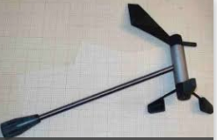
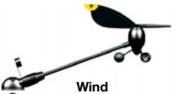
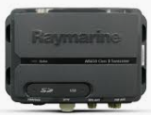
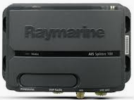
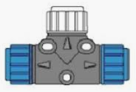
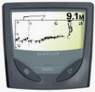
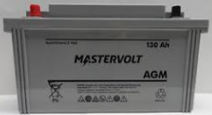
Old
12V
Signal
ST ng spur
ST ng backbone
ST
VHF
GPS
NMEA0183
YDWG-02
MS-RA70N
eS7
ST4000+
ST60
tridata
ST60
wind
AIS-100
AIS-650
RAY-215 DSC
EchoPilot
FLS
12V
FLS
Steering Pedestal
Nav Station
Mast Base

Slide 2
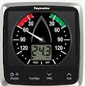
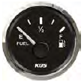
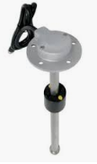
To be
12V
Signal
ST ng spur
ST ng backbone
ST
VHF
GPS
NMEA0183
YDWG-02
MS-RA70N
eS7
ST4000+
i60
wind
i70s
AIS-100
RAY-215 DSC
AIS-650
Fuel
iTC-5
DST-800
KUS NS5 Fuel
ST60
tridata
ST60
wind
EchoPilot
FLS
FLS
12V
Steering Pedestal
Nav Station
Mast Base

