Slide 1
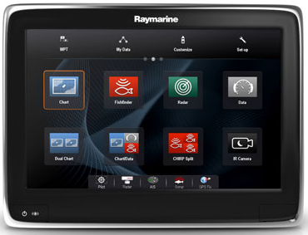
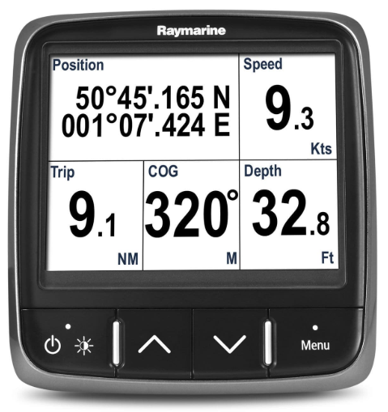
A128 Chart Plotter
i70 MFD
12V power
SeaTalkNG Spur
SeaTalkNG Spur
SeaTalkNG
Terminator
SeaTalkNG
Terminator
12V power

