Slide 1
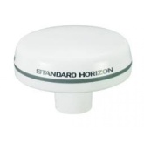
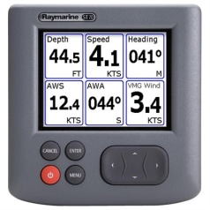
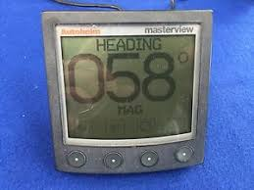
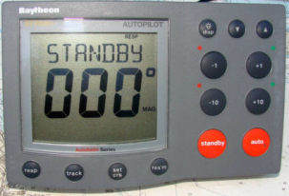
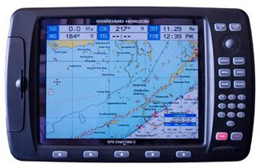
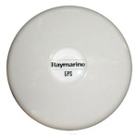
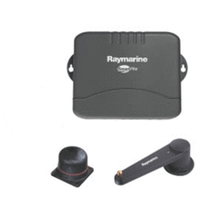
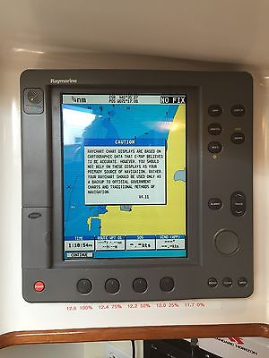
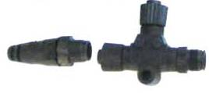
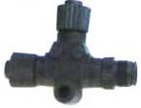
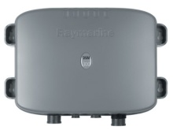
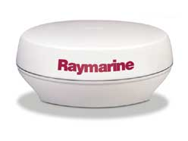
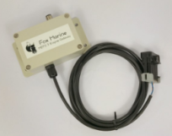
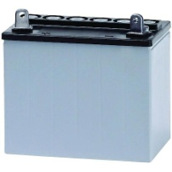
ST70 MFD
ST80 Masterview
ST70 MFD
ST8001 Pilot
CP 1000c
Sea Talk + power
Sea Talk Only
Sea Talk ng
Sea Talk ng
NMEA 0183
Sea Talk ng to NMEA 2K
Custom Spliced Cable
S1G
RL80CRC
Sea Talk hub
Sea Talk + power
- Field spliced STng backbone to N2K Device Net Backbone - STng powered from Devicenet backbone - ST70s used to display Fox MEFI Gateways primarily -RL80RC used primarily for radar and depth and backup GPS -Sea Talk Only used for display of ST data on ST70 if needed
NMEA 2000 backbone
DSM 300
Fox MEFI P Engine Monitor
Fox MEFI S Engine Monitor

