Slide 1
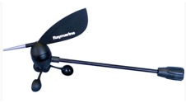
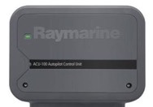
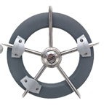
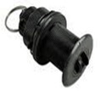
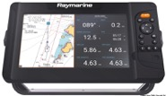
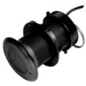
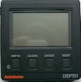
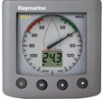
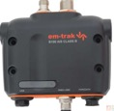
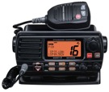
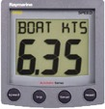
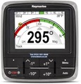
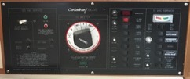
ITC-5 Converter Transducer to STng
Wind
Autopilot ACU-100 Actuator Control Unit
Raymarine Element 7S
ST4000 Mk2 Wheel Drive
Speed
EV1 Sensor Core
3 M
0.4M
1 M
9 M
5 M
0.4 M STng to Devicenet
Depth
ST50+ Depth
1 M STng to Devicenet
NMEA 0183
Existing
Em-Trak AIS
1 M
STng to ST1 Converter
ST60+ Wind
1 M STng Power
GPS Antenna
Std Horizon GX1500S VHF
Existing
ST60 Speed
AIS Antenna
VHF Antenna
0.4M
p70s
STng Backbone
STng Spur
Power
Coax
Seatalk1
OEM / NMEA 0183
Existing Components in Blue Italics
Navigation Station Power
- Fused as appropriate
Standard Horizon RAM3 Remote Mic
Draft System less i70s Display

